Slide 1
Battery Charger System Control (1) (2)
State Control (1)(2)
Data Analysis
(1)
ThingSpeak platform
ThingSpeak Adaptor (2)
Post-Process
Data-Analytics
Message Broker
Device Connector for RPI (1)
TelegramBot
Device Connectors
User Awareness
Device Connector for Arduino (2)
Legend:
Publisher
Subscriber
Catalog
MQTT communication
Rest Web Service (consumer)
Rest Web Service (provider)

Slide 2
Battery Charger System Control (1) (2)
State Control (1)(2)
Data Analysis
(1)
ThingSpeak platform
ThingSpeak Adaptor (2)
Post-Process
Data-Analytics
Message Broker
Device Connector for RPI (1)
TelegramBot
Device Connectors
Node-red
Device Connector for Arduino (2)
User Awareness
Legend:
Publisher
Subscriber
Catalog
MQTT communication
Rest Web Service (consumer)
Rest Web Service (provider)

Slide 3
ManualFlag=2
ManualFlag=0
ManualFlag=1
Receives data from sensors
Control Strategies every minute
Actuator OFF
Actuator ON
Actuator OFF
No
No
Car in Charge (Present in the garage)
% battery for daily appointment +15 < % battery
No
Yes
Solar Pannel
Yes
No
[% battery for daily appointment * 1,2]+15 (20% more than usual) < % battery
No
Conditioning ON (Temperature sensors)
Yes
Sunny day?
Yes
Yes
Actuator ON

Slide 4
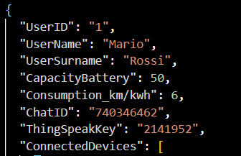
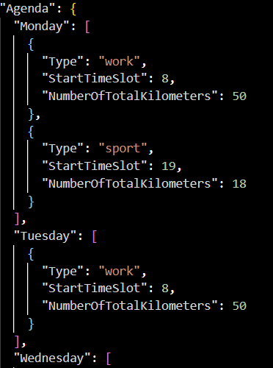


Battery Capacity (KWh)
Battery Consumption (km/KWh)
Autonomy of the electric vehicle with 100 % of battery (km)
Km necessary to cover all the daily appointment > max autonomy in km of the user’s battery?
Yes
No
Send an alert to communicate to the USER that the number of total km is too high so may be necessary to recharge the car between 2 appointment.
Send to the actuator control strategy the value of the battery’s percentage necessary for the following day.
EnergyNecessary $=\frac{NumberKmPerDay}{Battery Consumption}$[KWh]
Battery $=\frac{EnergyNecessary∗100}{Battery Capacity}$ [%]

Slide 5


Battery Capacity (KWh)
Battery Consumption (km/KWh)
Autonomy of the electric vehicle with 100 % of battery (km)
Yes
Km necessary to cover all the daily appointment > max autonomy in km of the user’s battery?
No
Send an alert to the USER.
Compute the value of the battery’s percentage necessary for the following day.
EnergyNecessary $=\frac{NumberKmPerDay}{Battery Consumption}$[KWh]
Battery $=\frac{EnergyNecessary∗100}{Battery Capacity}$ [%]

